Slide 1




The Road of Modern Globalization:
Expectations and Reality
AMDISA Conference, 11-05-2026, Thimphu
Professor Sergey Myasoedov,
Vice-rector RANEPA University,
Director/Dean IBS Moscow of RANEPA,
President of RABE (Russian association of business education)

Slide 2
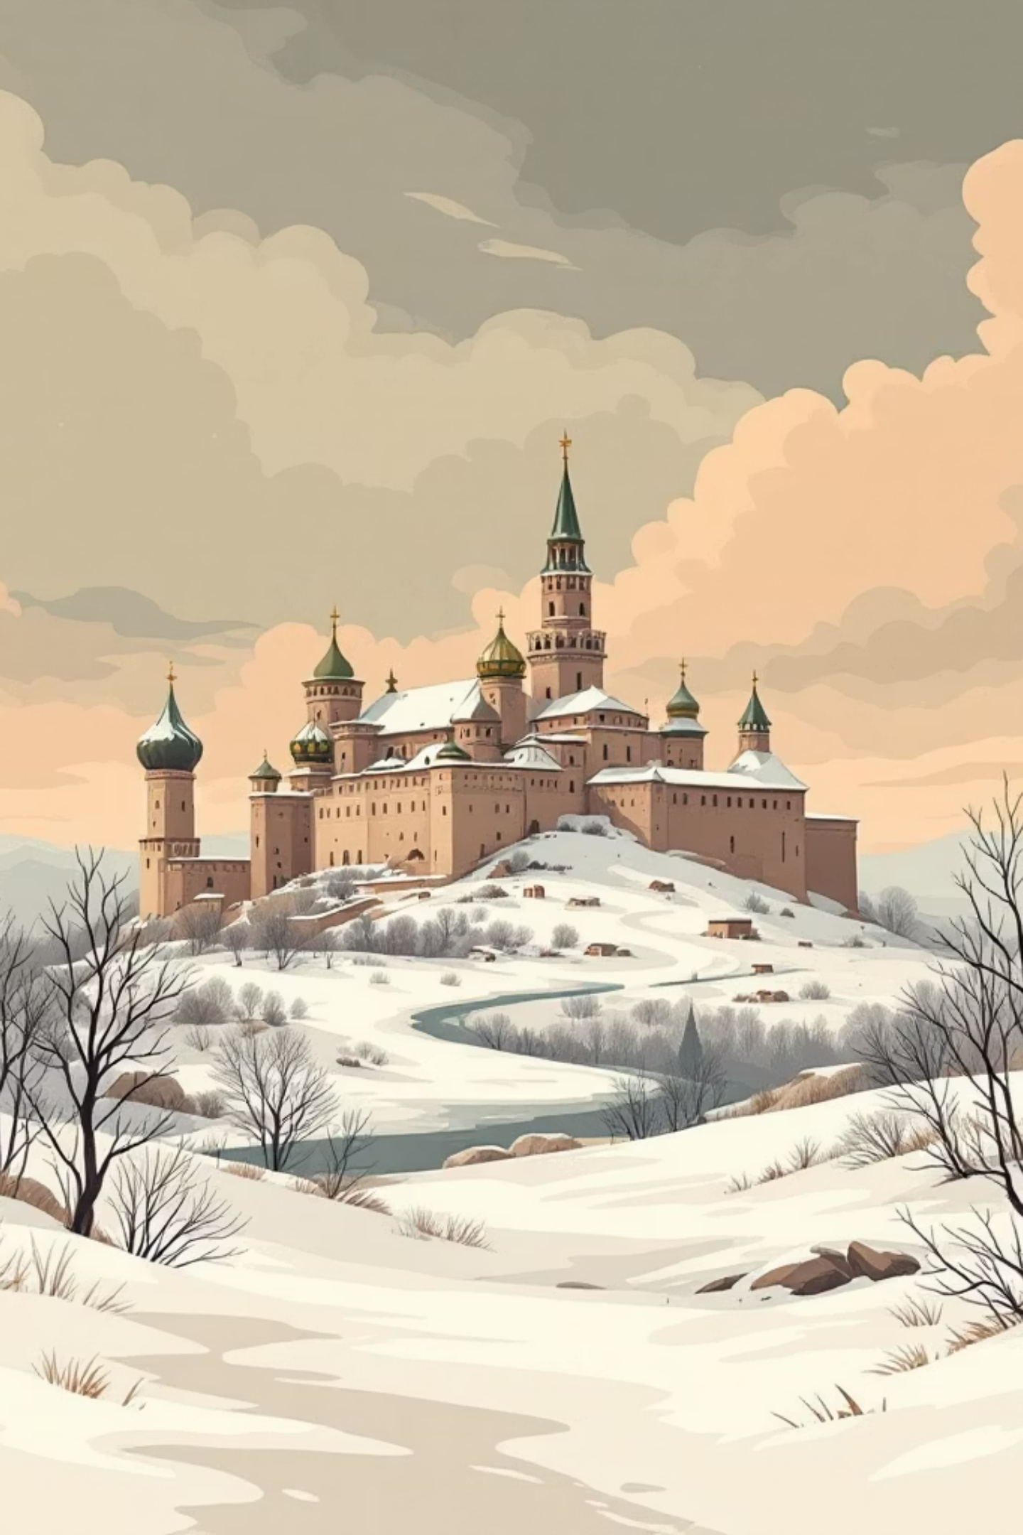
It is my pleasure and honor to discuss the problems of International cooperation in the field of BUSINESS-EDUCATION
Since the year of 1988 when I became the founding Dean of IBS-Moscow (AACSB, AMBA and EPAS accredited, №1 BS of Russia, № 30 in Europe, 27 double degree programs, comprising 2 EMBA – on the 43 and 46 places of top 100 by FT, Russian EMBA № 40) and always had a sustainable belief in the values of International cooperation I was happy about the word ”GLOBALIZATION” and taught my students the privileges of International subdivision of labor I was almost dizzy of those words.
Then the hangover came. Why? Politics of Russia and of some European countries went apart.
I was brought in the spirit that while the politicians are falling out, scientists, educators, musicians and athletes try to continue cooperation and maintain communication channels.
I expected to follow those principles. But 27 partners behaved like the puppets. And then I learned about double standards, so-called “political correctness”, and three hypocritic words: “It is different”. And constantly repeated verb “ to punish”.

Slide 3
We still believe in International cooperation.
Who are “we”? RABE – The Russian Association of Business Education: about a hundred well-positioned BSs and Centers,
Accreditations: 21 BS has at least one program accreditation of the Triple Crown Group. Three leaders: IBS-Moscow of RANEPA, SKOLKOVO, Graduate School of Management of SPbU.
Rankings: FT and Eduniversal + NACBE (National Council on Quality Accreditation Council of Business and Management Education)
Three price/quality levels of market presence: EMBA programs: 25-90 thousand USD; 10-15, 5-10.
Enrollment – about 5 000 executive students.
What was changed?
“GLOCALIZATION” (global +local). Cooperation with South and East
Development of the National accreditation system
Revision of management textbooks on the foundation of Traditional Moral principles and the national value system
Research on the Russian management model and the first text book on Russian management model development Research of Russian best practices in the field of management and their popularization
Support of cooperation with the world scientists and academics
Discussions and development of AI and EdTech tools and projects

Slide 4
Thank you!

